Slide 1

Sales Analysis & Forecasting
By Team-2

Slide 2
Goals and Objectives
About Us
Business Problems
Dataset Overview
Analysis
Forecasting
Marketing strategy
Table of
Contents

Slide 3

GOALS AND OBJECTIVES
Objective n° 1
Objective n°2
Objective n°3
Conduct a thorough analysis of the sales data to uncover areas where the owner may be falling short or lacking in their approach, providing valuable insights for improvement
Identify top-performing products
and regions
Recommend strategies for
improving sales

Slide 4

ABOUT US
We have conducted a comprehensive analysis of our sales dataset, encompassing order information, ship dates, sales figures, profit margins, and discounts. Through this analysis, we have uncovered valuable insights that provide a holistic view of our sales operations. In our upcoming presentation, we will delve into these findings, discussing key trends, performance metrics, and areas of opportunity. This exploration aims to offer a nuanced understanding of our sales dynamics, empowering strategic decision-making for the continued growth and success of our business.

Slide 5

BUSINESS PROBLEMS
Inconsistent Sales Performance:
Problem: Fluctuations in sales numbers and inconsistent performance.
Ineffective Sales Strategies:
Problem: Sales strategies that do not resonate with the target audience.
Market Saturation:
Problem: Facing a saturated market with intense competition.
Mismatched Sales and Marketing Efforts:
Problem: Lack of alignment between sales and marketing teams.

Slide 6
DATASET OVERVIEW
Dataset Consists of
Shipping Methods:
Ship Mode details (e.g., first, second, etc..,).
Geographic Data:
Customer location data:
Country, City, State, Postal Code, Regional Categorization(Region)
Product Information:
Product Name.
Categorization by type (Category).
Further specification into sub-categories (Sub-Category).
Sales Transaction Details:
Product details:
Name, Sales amount (Sales), Quantity sold (Quantity), Applied discount (Discount)
Resulting profit (Profit)
Payment Preferences:
Insights into customer payment modes (Payment Mode).

Slide 7


ANALYSIS
Total sales : $22,97,200.86
Total profit : $2,86,397.02
Total discount : $1,561.09
Max profit of the sales : $8,399.98
Max sales per day of total sales : $22,638.48
Avg sales per day : $229.86

Slide 8

TOP 5 STATES AND CITIES OF SALES AND PROFITS
STATES | SUM OF SALES($) | STATES | SUM OF PROFITS($)
California | 4,57,687 | California | 76,981
New York | 3,10,876 | New York | 74,038
Texas | 1,70,188 | Washington | 33,402
Washington | 1,38,641 | Michigan | 24,463
Pennsylvania | 1,16,511 | Virginia | 18,597
CITIES | SUM OF SALES($) | CITIES | SUM OF PROFITS($)
New York | 2,56,368 | New York | 62,360
Los Angeles | 1,75,851 | Los Angeles | 30,440
Seattle | 1,19,540 | Seattle | 29,156
San Francisco | 1,12,669 | San Francisco | 17,507
Philadelphia | 1,09,077 | Detroyt | 13,181

Slide 9
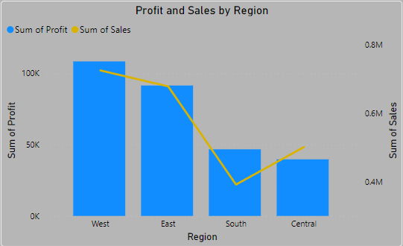
REGION ANALYSIS
Western Region:
1. Total Sales: $725,475 2. Total Profit: $108,418
Dominant contributor to both sales and profit.
2. Eastern Region:
1. Total Sales: $678,781 2. Total Profit: $91,522
Strong performance in sales and profit.
3. Southern Region:
1. Total Sales: $391,721 2. Total Profit: $46,769
Moderate sales and profit contribution.
4. Central Region:
1. Total Sales: $501,239 2.Total Profit: $39,706
Sales and profit at a moderate level.

Slide 10
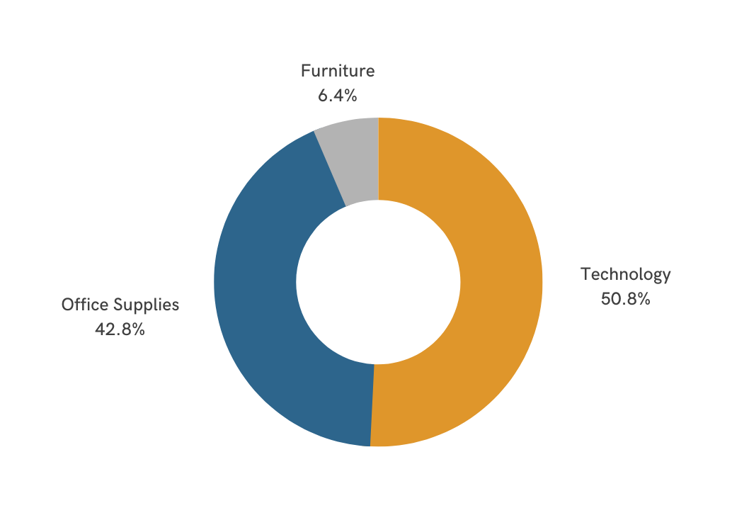
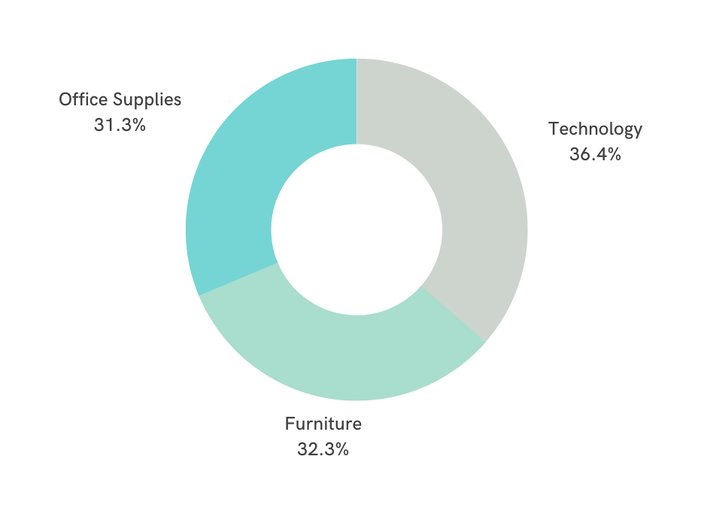
Categories Analysis
Sales
Profit

Slide 11
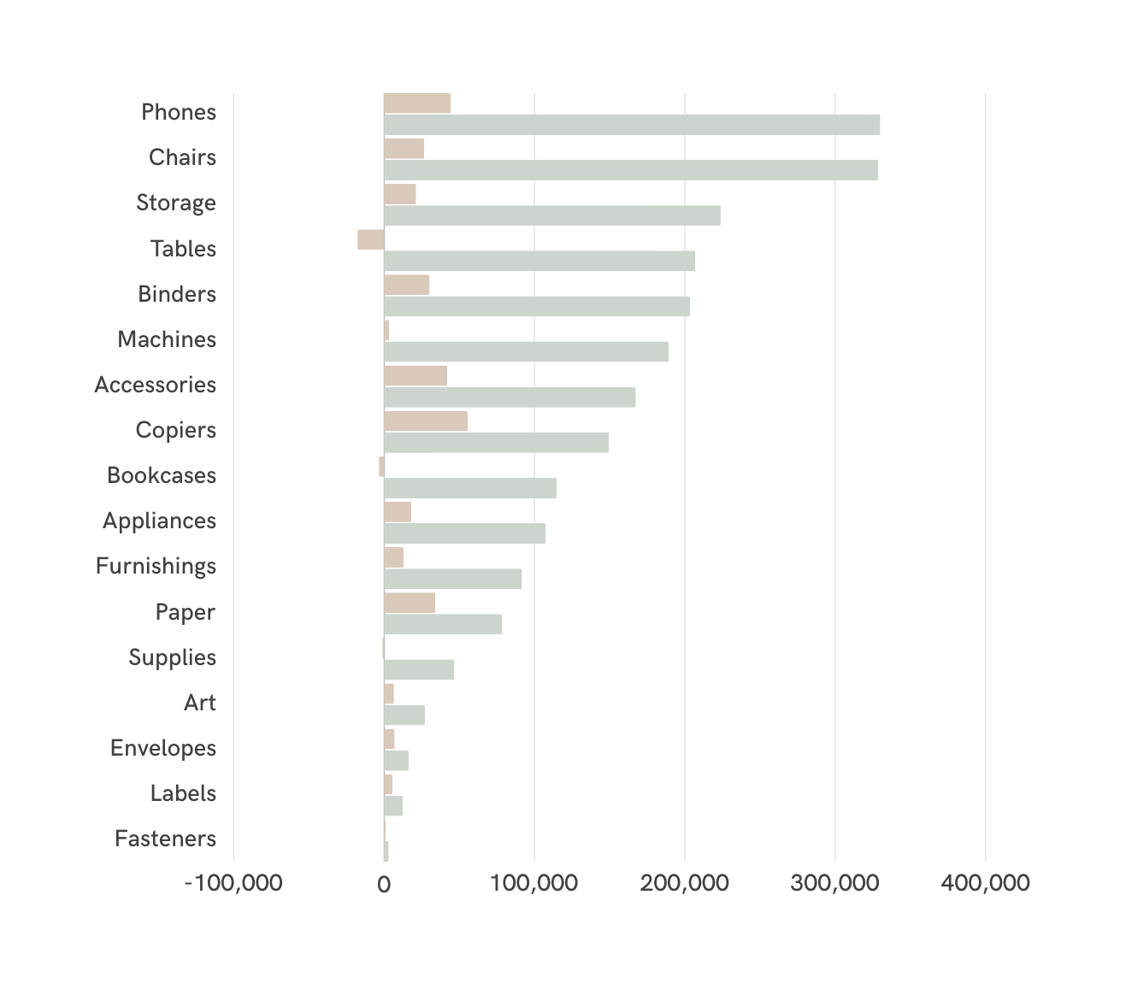
Sub-Categories
Phones:
Highest Sales and Profit.
Recommendation: Increase stock to meet demand.
Chairs:
High Sales and Profit.
Recommendation: Ensure ample stock availability.
Copiers:
High Profit despite lower sales.
Recommendation: Focus on promoting and increasing stock.
Accessories:
Moderate Sales but High Profit.
Recommendation: Strategize to boost sales, consider promotions.
Fasteners and Labels:
Low or No Profit despite Sales.
Recommendation: Evaluate profitability, consider adjustments.
Tables:
Good Sales, No Profit.
Recommendation: Reevaluate sales strategy or consider discontinuation.
Profit
Sales

Slide 12


The Top 5 sales by customers along with their names and the percentage of sales they represent:
1. Sean Miller: $25,043 (16.28%)Sean Miller holds the top position with sales totaling $25,043, contributing to 16.28% of the total sales. His consistent performance makes him a key customer for your business.
2. Tamara Chand: $19,052 (12.39%)Tamara Chand secures the second position with impressive sales of $19,052, representing 12.39% of the total sales. Her loyalty as a customer is valuable for sustained business success.
3. Raymond Buch: $15,117 (9.83%)Raymond Buch follows closely with sales worth $15,117, making up 9.83% of the total sales. His consistent purchases have a significant impact on your revenue.
4. Tom Ashbrook: $14,595 (9.49%)Tom Ashbrook's purchases total $14,595, contributing to 9.49% of the overall sales. His consistent support is an asset to your business.
5. Adrian Barton: $14,473 (9.42%) Adrian Barton is in fifth place, with sales of $14,473, representing 9.42% of your total sales. His continued business engagement is a significant factor in your success.

Slide 13
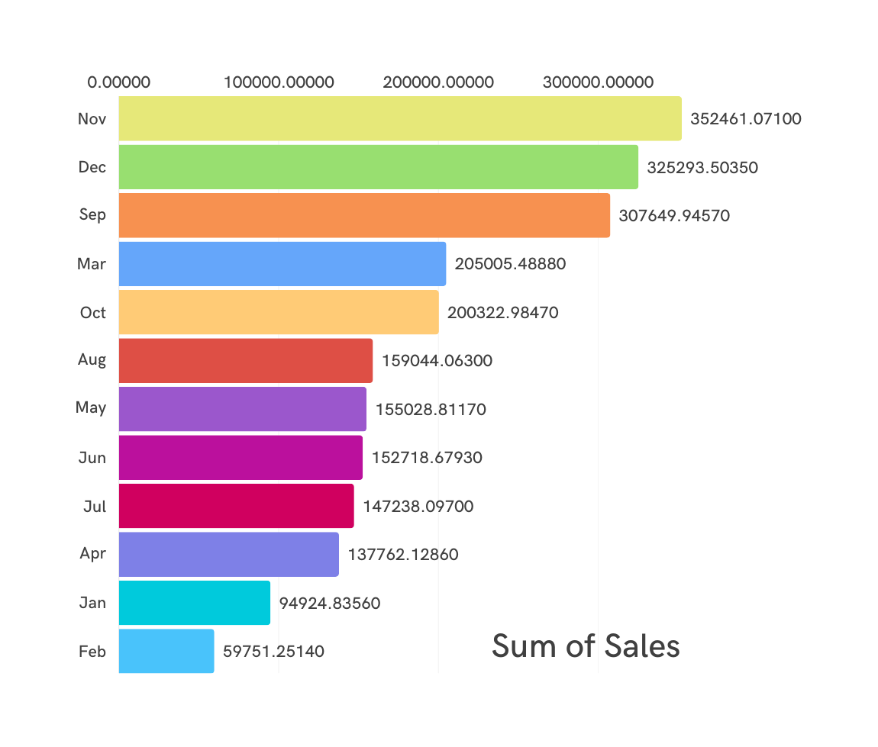
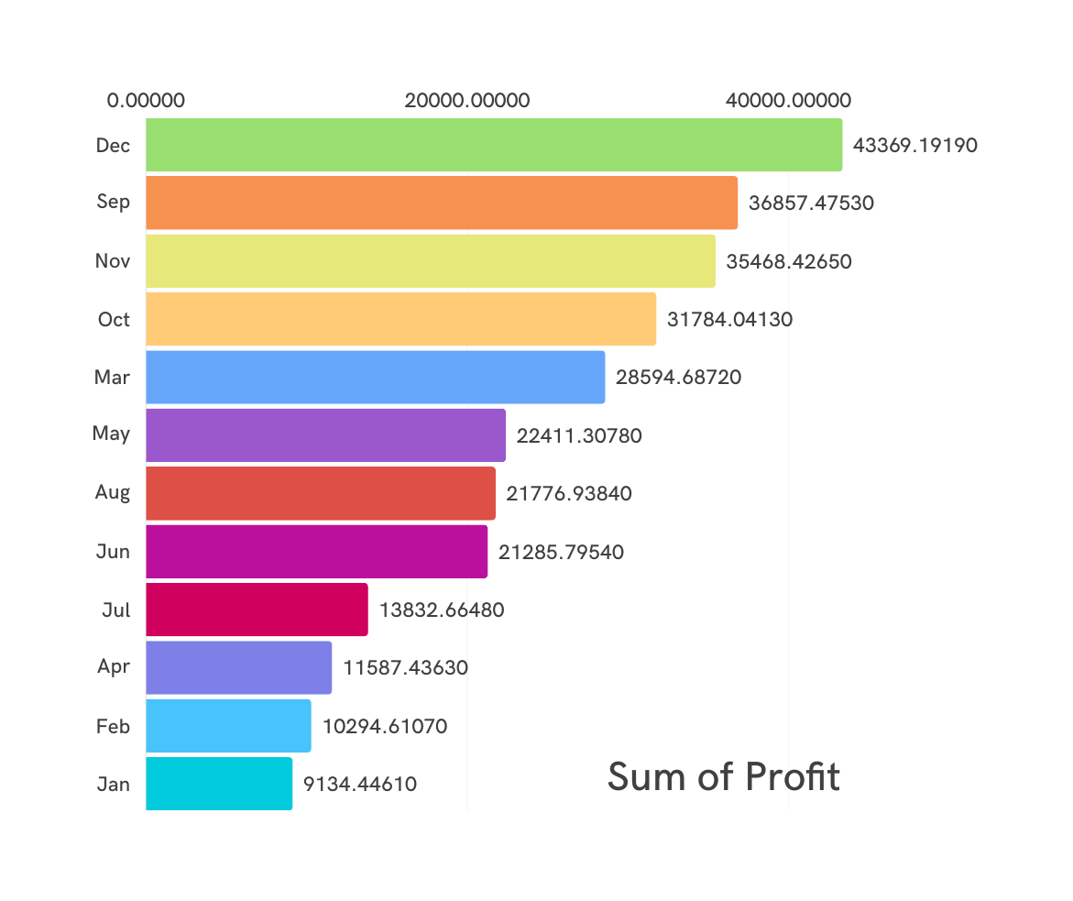
Month Wise Overall Sales & Profit Analysis

Slide 14
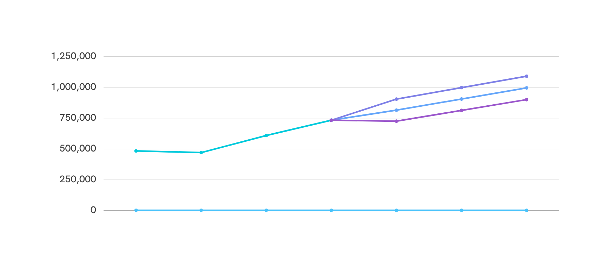
Sales Forecasting
Expected Sales Growth Over Time
Current month sales

Slide 15
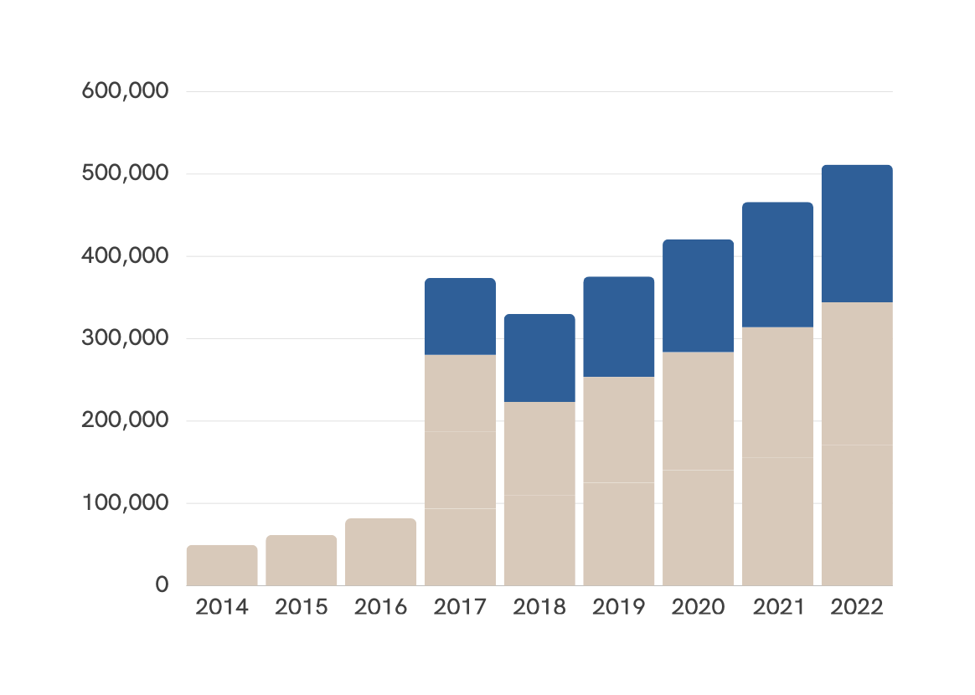

Profit
Monthly sales growth
Anticipating a positive correlation between sales and profit.

Slide 16
Marketing Strategy
Implement marketing strategies for increased sales and profitability.
Boost Michigan sales and profit; capitalize on Detroit's profitable market.
Offer discounts on offline supplies and technology to drive sales.
01
02
03
Attract customers with monthly discounts and gift vouchers every quarter.
Halt sales of unprofitable products to optimize overall profitability.
04
05

Slide 17

Thank you!

